Slide 1

BookBuddy: Your Book Recommendation Chatbot
An AI-powered chatbot designed to provide personalized book suggestions, built using IBM Watson Assistant. Presented by Shraddha Tripathi from United Institute of Technology.

Slide 2



Why Name Your Chatbot?
Humanizes Interaction
Builds Trust
Enhances Recall
A relatable name fosters a stronger emotional connection with users.
A memorable name improves brand identity and user retention.
Names make the chatbot feel more like a conversational partner.

Slide 3

Why "BookBuddy"?
The name "BookBuddy" perfectly encapsulates the chatbot's role: friendly, approachable, and directly relevant to the world of books.
It implies a helpful, reliable companion for every reader, making the experience personal and engaging. Its simplicity also ensures it's easy to remember.

Slide 4



Key Features of BookBuddy
Personalized Recommendations
Natural Language Understanding
Multi-Genre & Author Suggestions
Tailored suggestions based on individual user reading preferences.
Enables smooth, intuitive conversations with users.
Provides diverse book choices with concise summaries.

Slide 5
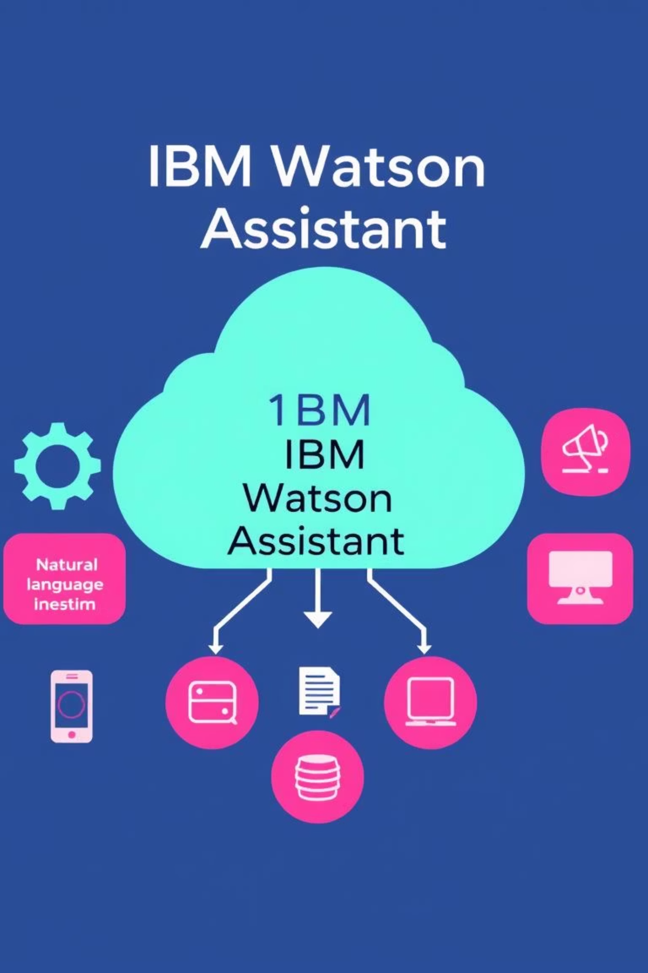
IBM Watson Assistant Overview
IBM Watson Assistant is a powerful AI platform for creating sophisticated conversational interfaces. It leverages Natural Language Processing (NLP) to accurately interpret user intents and contextual nuances within conversations. The platform is highly versatile, supporting seamless integration across multiple channels, including web and mobile applications, ensuring a consistent user experience.

Slide 6

How BookBuddy Works
User Inputs
Watson Assistant
BookBuddy Suggests

Slide 7
Development Process
Testing & Refinement
Training with Data
Rigorously testing and refining the chatbot for optimal accuracy and an exceptional user experience.
Conversation Flow Design
Training the chatbot with diverse sample dialogues and comprehensive book metadata for accurate understanding.
Designing intricate conversation flows and defining intents within Watson Assistant to guide interactions.

Slide 8

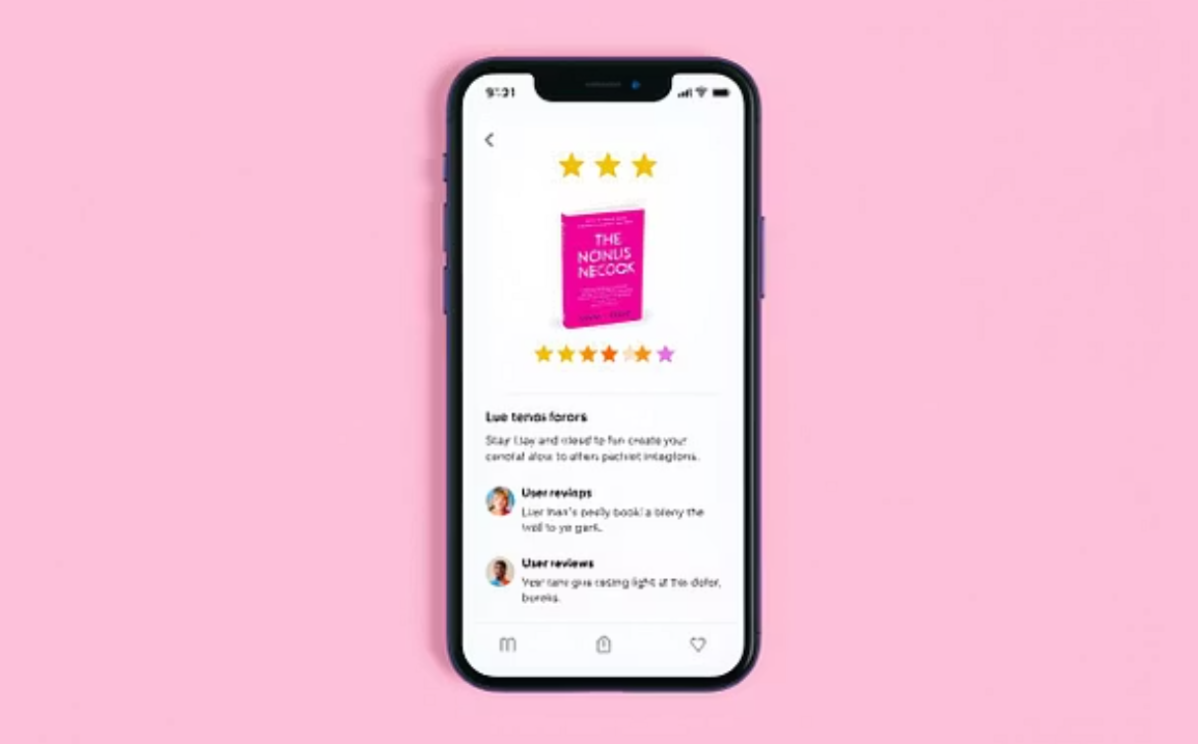

Future Enhancements
Adding voice interaction capabilities for a more natural interface.
Integrating user reviews and ratings to enrich recommendations.
Expanding to recommend articles and research papers for broader knowledge.

Slide 9

Thank You
BookBuddy
Presented by Shraddha Tripathi
United Institute of Technology

